Slide 1
CS 499 Group project: Fade
Group members: Yijun Gan, Ji Cui, Yuwen Hu, Ruiheng Ma

Slide 2
Our circuit diagram
Resistance
This is a simple series circuit. It has a 5 V power and a 220 Ω resistance and a LED. Which the resistance and the LED are series connected.
220 Ω
+
Power
5V
-
LED

Slide 3
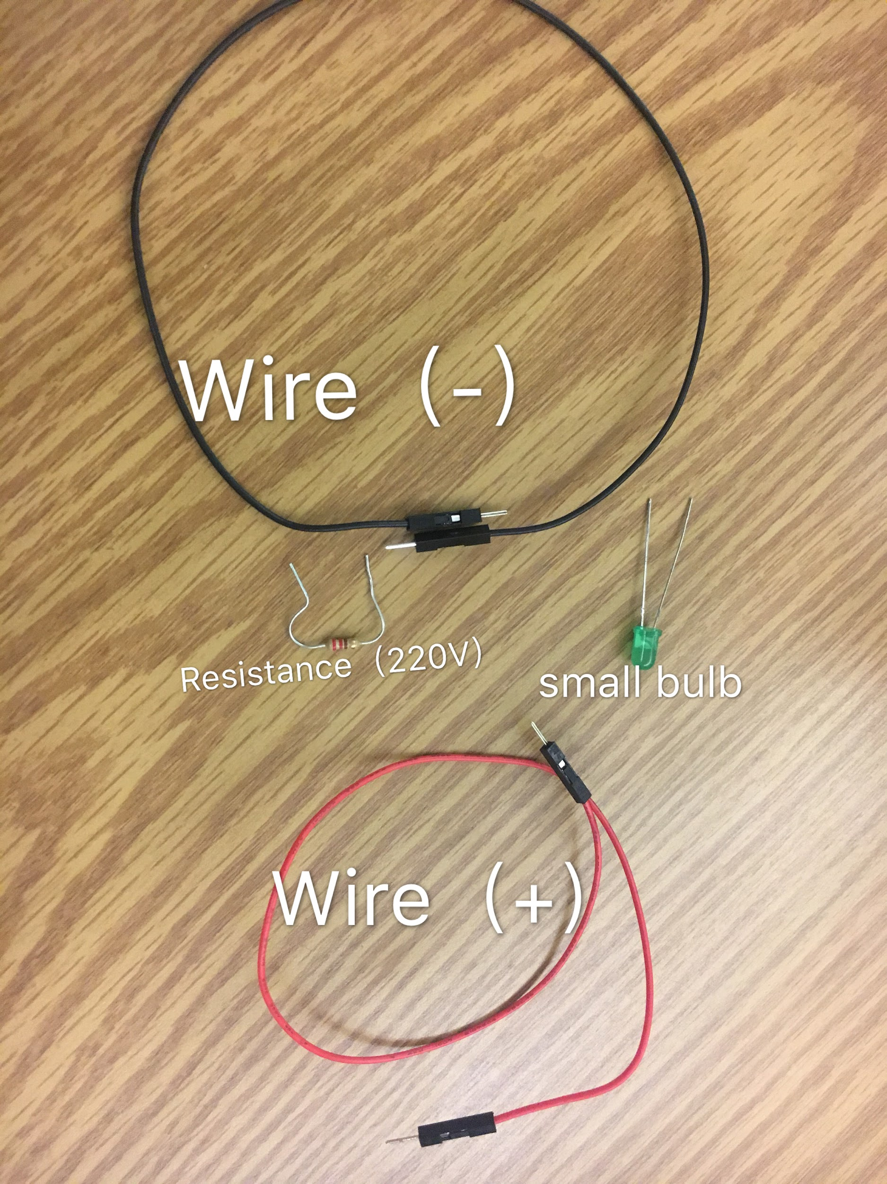
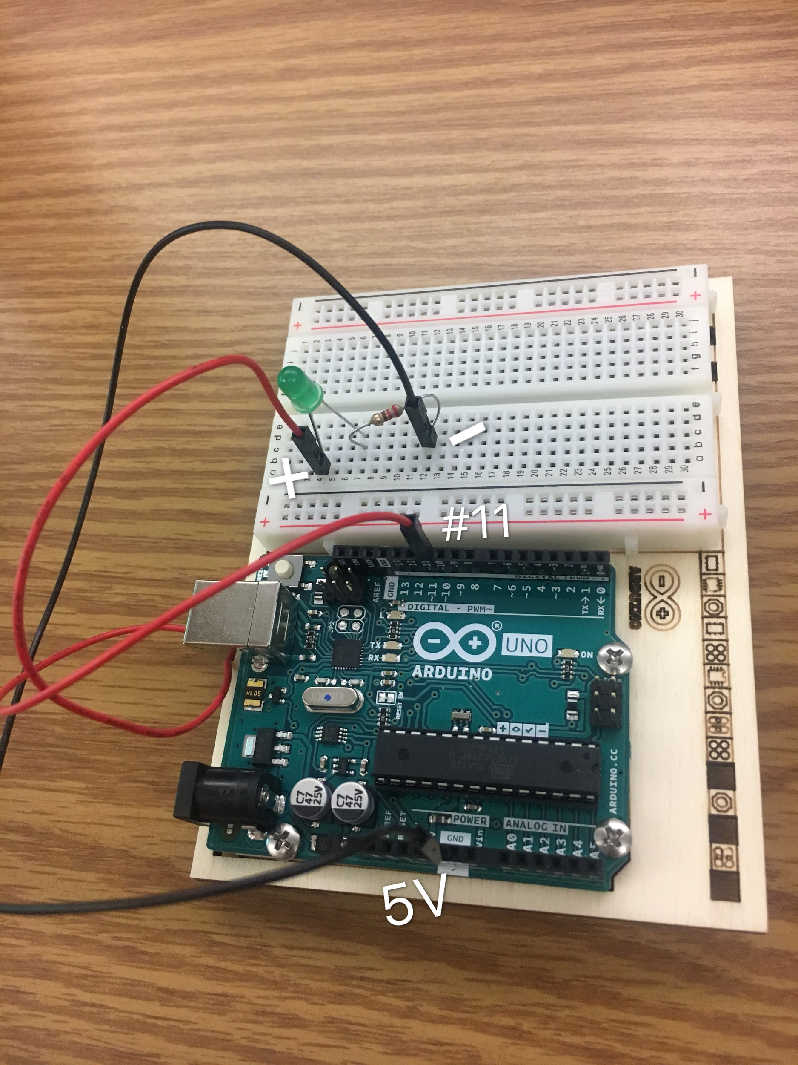
Items that We Used in this Project(1)
Two wires
One resistance (220Ω)
One small bumb
Bread board
Operating Panel

Slide 4
How to Connect
The positive is connecting with alternating current (#9----#11).
Then concatenate everything

Slide 5
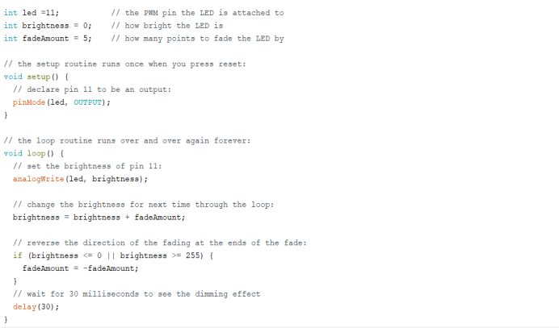
The Analysis for Codes

Slide 6
1.Void setup( )------> this is the function, and void means that this function won’t return anythings. It is just used for declaring pin 11 to be an output.
2. analogWrite(pin, value)-------> Writes an analog value (PWM wave) to a pin,Can be used to light a LED at varying brightnesses or drive a motor at various speeds, and this function is finished by arduino. Pulse Width Modulation( PWM), is a technique for getting analog results with digital means. Digital control is used to create a square wave, a signal switched between on and off.
3. In order to make LED fade up and light up, the value of PWM from 0(off) to 255(on).
4.1. Delay controls the speed of the gradient

